Slide 1
tinyurl.com/ hackhyland2023
Everything you need to know for the Hackathon, all in one place!

Slide 2

Strive for Greatness
tinyurl.com/hackhyland2023

Slide 3
Sunday Schedule
8:30-10:30AM | Grab-n-Go Breakfast | Hallway
11:30PM-12:30PM | Workshop: Presenting 🖌️ | Auditorium
12:30-1:30PM | Lunch | Hallway
3:00PM | + Code Cut Off + | Workstations
3:30PM | Judging Begins | Auditorium
6-6:30PM | Dinner | Auditorium
6:30-7PM | + Closing Ceremony + | Auditorium
Full schedule available at tinyurl.com/hackhyland2023

Slide 4

Remember to stay hydrated
tinyurl.com/hackhyland2023

Slide 5
📶
Get Connected
Wi-Fi Network: Hackathon
Password: HylandSoftware!
tinyurl.com/hackhyland2023

Slide 6

Shoot for the Stars
tinyurl.com/
hackhyland2023

Slide 7
Earn Raffle Tickets
⚒
Attend Workshops
😇
Be Nice
❔
💪
Ask Good Questions
Work Hard
🎴
Help Others
WIN PRIZES
tinyurl.com/hackhyland2023

Slide 8

Don’t sweat the small stuff
tinyurl.com/hackhyland2023

Slide 9
Hold up!
Have to leave the building? Make sure you sign out with a mentor before you depart.
More information at tinyurl.com/hackhyland2023

Slide 10

Make every experience a learning experience
tinyurl.com/hackhyland2023

Slide 11


Contact
Discord
Phone
Email
Reach mentors and facilitators online
Caitlin: (216) 469-4921
Marissa: (216) 314-7660
Joseph: (216) 218-2609
Visit the Mentor Room
Send a message to techoutreach@hyland.com
More information at tinyurl.com/hackhyland2023

Slide 12

Take Time to Relax
tinyurl.com/hackhyland2023

Slide 13
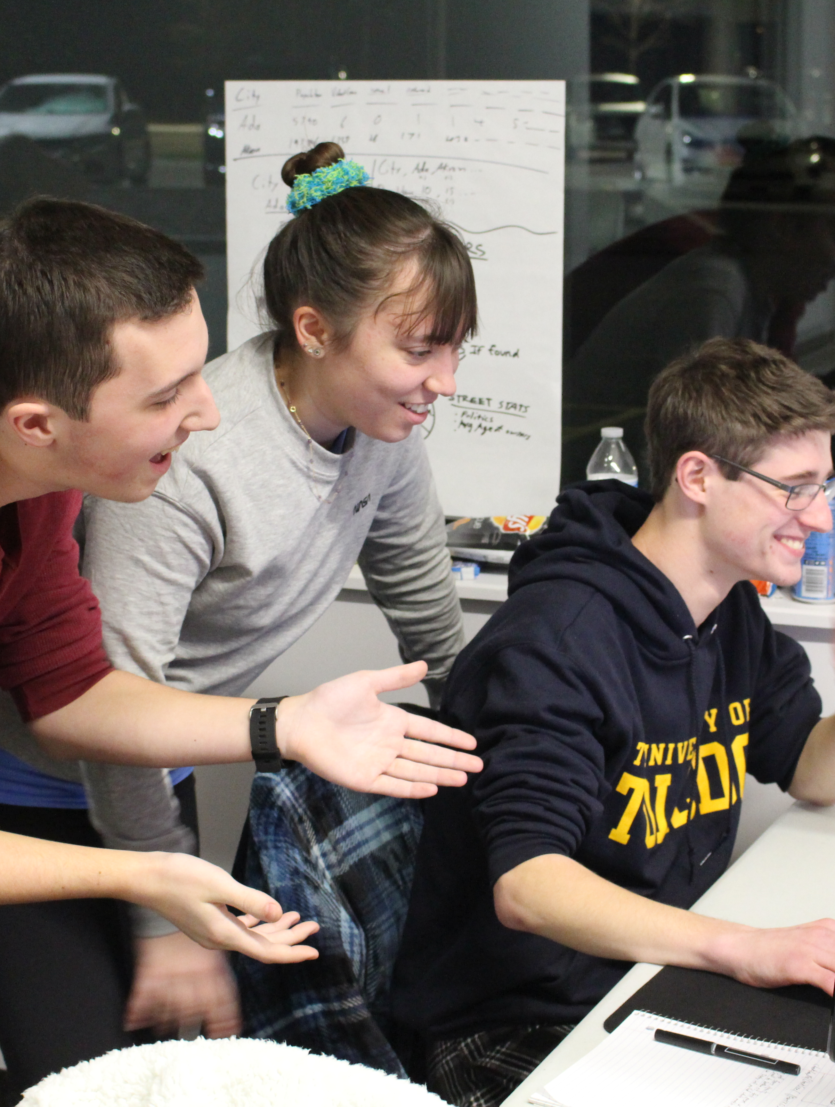
Photos & Posts
Share your Hackathon experience with the world
Use #HylandHackathon on your posts for a chance to be featured on Hyland social media 😎
tinyurl.com/hackhyland2023

Slide 14

Believe in Yourself
tinyurl.com/hackhyland2023

